Slide 1
The effect of magnetic field on the
destruction petroleum emulsion
N. Mamulaishvili¹, G. Partskhaladze²,
G. Chavleshvili³ , O. Janelidze⁴
1- Associated Professor. Batumi Shota
Rustaveli State Univefsity, Georgia;
e-mail:n.shvili@rambler.ru ;
nora.mamulaishvili@bsu.edu.ge
GEORGIA > BATUMI 2019w.

Slide 2
The report reviewed,
Problems in the technology of Petroleum production at the Supsa field are Petroleum emulsions and their demulsification. Emulsions are formed during Petroleum production.
The stability of such an emulsion depends on the content :
Paraffins 3.9%
asfalthenes, 7.74 %
resins, 20.3 %
impurities 0,021 %
and water. 32 -34 %
Consequently, the extracted Petroleum must be pre-treated for further transportation.
The article shows the effectiveness of the influence of the magnetic field on the process of destruction of the Petroleum emulsion.
The results of the process of demulsifying crude oil under the influence of the magnetic field of low and high frequencies (Hertz).

Slide 3
Supsa crude oil's physical parameters
Options | values
1. Density 20⁰C, c / cm³ 2.Cinematic Viscosity 20⁰C, mm 2 / sec 3.The strength of the firm is ⁰C 4.share of water % ; | 0.8864 11.874- 15.85 0 32-34

Slide 4
The traditional methods of destruction of water-steam emulsion are:
Gravity method. using the forces of gravitational collapse, which implies the removal of water droplets into the aqueous emulsion
Filtration. The filtering method involves the destruction of the emulsion using a filter material.
Centrifugation. Centrifuge means centrifuging,, is an emulsion of high-speed emulsion with an inert force, and the emulsion differs from the water and oil layers due to its different density.
Thermal Exposure .Thermal exposure to an oily emulsion means that the oil is dehydrated before it precipitates. To do this, it warms up to 45-80 degrees Celsius, such heating reduces the viscosity of the Petroleum, and it destroys
Surface-active substances (SAS) are widely used in Petroleum -producing practice .

Slide 5
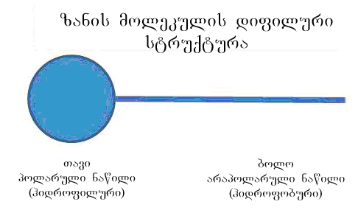
Structural composition of the molecule. (SAS)
Any zonoid molecule (SAS) consists of two parts:
a polar part has a hydrophilic properties, and
a hydrophobic part
of the hydrophobic properties,.

Slide 6
In Factors affecting the process of deemulsg
The effect of PH / Practice has shown that the acidic layer of water increases the strength of the emulsion <7, and if рn> 7, then the emulsion is weakened.
The effect of the mineraliziti of the water layer adversely affects the destruction of the emulsion, the greater the salinity of the water, the more stable the emulsion.
Exposure to temperature. With increasing temperature, the viscosity of the system decreases and the emulsion resistance decreases.
The impact of turbulence. An important factor is the change in the flow regime from laminar to turbulent mode, which causes the destruction of emulsion
Increases stability ; Decreases stability

Slide 7
Petroleum
75 - 80 ºC
Crude Petroleum
Temperature
Water

Slide 8
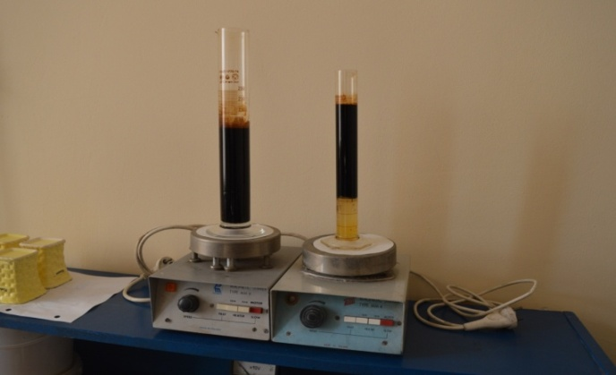
Fig . 3. The demulsifier during operation. BSU. Laboratory of Petroleum and Gas. Faculty of Technolog .
The samples were prepared in the graduated Cylinders in amount of 100 ml each. Then we injected determined quantities of demulsifier into each sample (0.005 – 1.0 l).
The process of demulsification lasted at T=20-22ºC . during 30-40 minutes resulting origination of two separated phases: the upper phase of Petroleum and the lower phase of water .

Slide 9
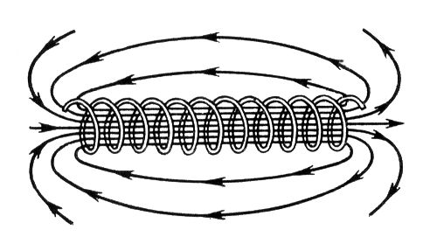
To increase the speed of the process solenoid
The solenoid core was made of Ferrite:
Long : 140 mm.
diameter : of 8mm.
Top wrapped with copper conductor.
A low-frequency current in the range of 20–50 hertzs was passed through a solenoid in the samples under study and observed during the process of water separation. see figure 1.

Slide 10
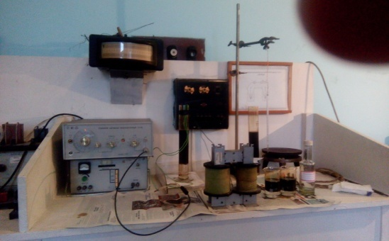
Method 1.
The method involved carrying out a demulsification process using magnetic solenoid, which was omitted in the test sample.
Samples were prepared in graduated Cylinders of 100-250 ml each. Then we injected certain amounts of the demulsifier into each sample (0.5-1.0 ml). At T = 20-22ºC. Then, a low-frequency current of 20-40 hertz was suppressed and observed during the demulsification process. As a result, two separate phases were formed: the upper phase of petroleum and the lower phase of water.

Slide 11
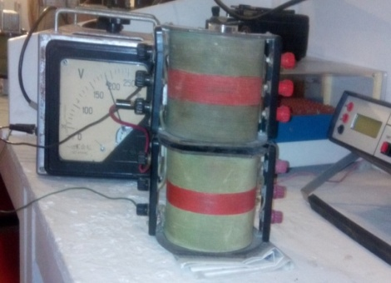
Method 2.
This method involves processing samples at higher magnetic field frequencies. Graduated cylinders with the test solution were placed in a coil and a voltage of 150-180 volts was applied. The frequency of the magnetic field varied from 20 to 80 hertz determined.

Slide 12
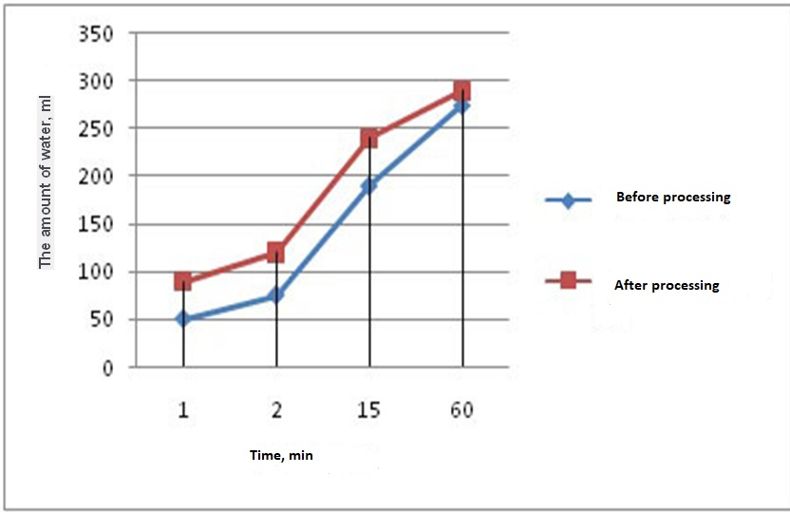
To increase the speed of the process.
process using a magnetic field and without a magnetic field

Slide 13
Conclusions
The results obtained when testing both methods revealed that the process of deemulsification of the Petroleum emulsion effectively takes place at the initial stage of the process within 30-40 minutes, at a magnetic field frequency of 30 Hertz.
A further increase in the volume of allocated water was not observed.
It is shown that the low-frequency magnetic field significantly increases the rate of separation of the water-Petroleum emulsion in the presence of a demulsifier.

Slide 14
References
[1] A.M. Shaikhulov, A. A. Bojchuk, V. А. Dokichev, S. E. Svirsky, V. H. Singizova, I. V. Krestеlevа, А. G. Tеlin,Magnetik field effect on demulsificationof water –in-oil emulsion of Kiengorskoe field a4 formation. ж. Нефтегазовое дело. 2014, т. 12, № 1
[2] . "Alkan202" https://elibrary.ru/item.asp?id=15229926
[3]. N. Mamulaishvili, N Salimova, T Khitarishvili and G. Partskhaladze
Regulation of filtration and reservoir features of oil stratum rock with use of compositesolutions of
SAS. J.Pet Environ Biotechnol 2018, Volume 9 DOI:10.4172/2157-7463-C1-041 ;
3rd World Congress on Petroleum Engineering and Natural Gas Recovery. July 20-21, 2018
Sydney, Australia.
[4]. N. Mamulaishvili , G. Partskhaladze, G. Chavleshvi i , R.Zoidze . International Journal
of Engineering Innovation & Research. Volume 6, Issue 6, ISSN: (2277 – 5668) ; Supsa Crude Oil Demulsification Technology Development by Usingnon-ionogenic Surfactant Solution. 2017.
[5].Mamulaishvili N.D., Salimova N.A., Khitarishvili T.D., Baladze D.A. Effect of various classes SAS on hydrophobic surface of oil stratum.The ''International journal of Appled and fundamental research’’
№2, 15-21.11.2014 Munch. Germany; http://www.science-sd.com/457-24744

Slide 15
attention.
Thank you for your

