Slide 1
ქართველ მუჰაჯირთა საბავშვო ფოლკლორი
თინა შიოშვილი

Slide 2
xalxuri sabavSvo Semoqmedeba ZiriTadad sam nawilad iyofa:
1. zepirsityvieebis nimuSebi, romlebic uSualod bavSvTa wreSia Seqmnili;
2. zepirsityvieri nawarmoebebi, romlebic Seqmnilia mozrdilTa mier bavSvebisaTvis,
3. erovnuli folkloruli Semoqmedebis is nawili, romelic specialurad bavSvebisaTvis ar Seqmnila, Tavdapirvelad sxva daniSnulebisa iyo da mxolod Semdgom daukavSirda bavSvTa repertuars.

Slide 3
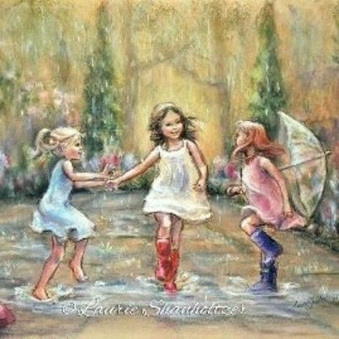
sabavSvo zepirsityvierebis nimuSebi ბოლო დრომდე Semoinaxes TurqeTis respublikis sxvadasxva regionSi migrirebul qarTvel muhajirTa STamomavlebma; maT repertuarSi vxvdebiT:
saakvno, salalao da Sesaqcevar leqs-simRerebs, gamosajavreblebs, leqsebs cxovelebze, sabavSvo TamaSobebsa da maTTan dakavSirebul gaTvlebs.

Slide 4
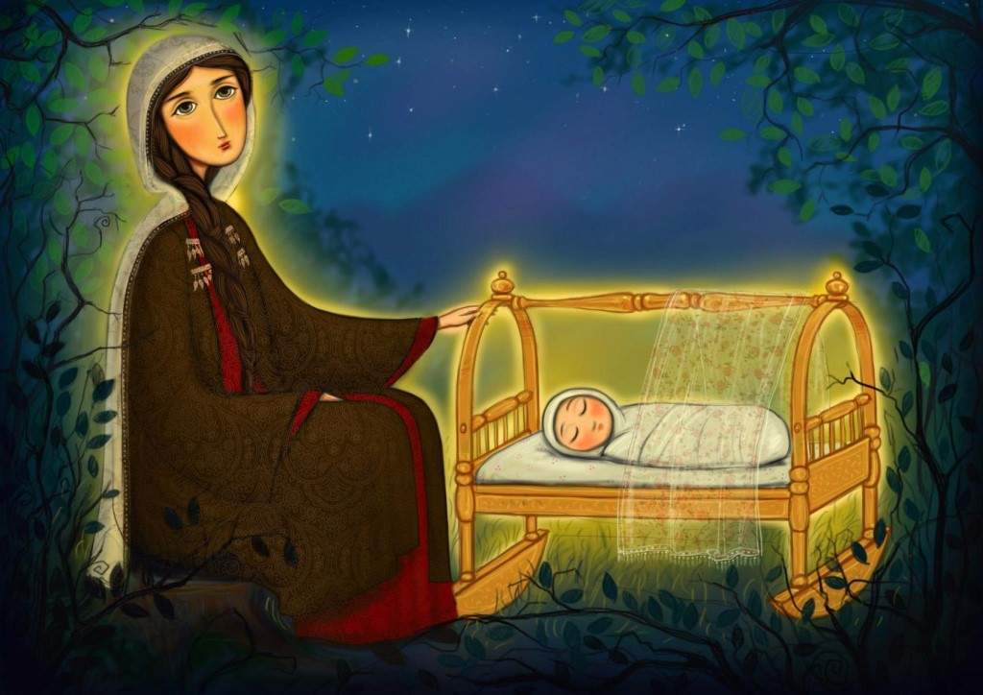
1. ს a a k v n o
bavSvis daZinebasTan dakavSirebuli egreTwodebuli saakvno leqs-simRerebi CvenSi ZiriTadad “nanas”, “naninas”, “iavnanas” saxelwodebiT aris cnobili. isini qalTa repertuars warmoadgenen da genetikurad mzisa da nayofierebis qalRmerT nanas ukavSirdebian. amave terminiT moixsenieben qarTvel muhajirTa STamomavlebi ymawvilTa dasaZinebel leqs-simRerebs: “baRanas duunanieb, daaZineb”, _ gviTxra giresunis provinciis bulanjaqis raionis sofel damudereSi mcxovrebma 53 wlis jihan Sardam (Caiwera Tina SioSvilma 2015 wlis 20 ivliss).
bursis provinciis gemleqis raionis sofel haidarieSi (Zveli saxelia eljeva) 2014 wეls Caweril saakvno leqs-simRerის mTqmelis ganmartebiT, Zvelad “akvanSi awvenden da umRerebden”:
e, neni, neni,
iZine, geÁzarde,
askeri gaxdi!
kaÁ gaxdio,
Áarali gaxdi!..

Slide 5
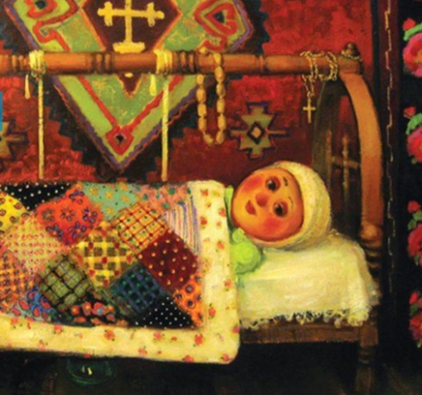
am saakvno leqs-simReras, Cvilisadmi siyvarulisa da misi gazrdis survilis garda, SemorCenia tradiciuli suliskveTeba qarTveli dedebisa, romlebic mamuls uzrdidnen erTgul damcvelebs; momavalSi Svilis “askerad” gaxdomis survili swored am asociacias unda ukavSirdebodes da sityvebic “Áarali gaxdi” (daWrili gaxdi //daiWeri) patrioti qarTveli dedebis namRer “nanebiseul” TezaTa ganmeorebaa. amis magaliTad gavixsenoT erT-erTi mesxuri “nana”:
gaizarde, pawawina,
Sen dediserTao!
Seni samSoblos sarTavi
Sen unda morTao!
es sityvebi yurSi gqondes,
gulSi _ ganZaTao!
guli basrad moixmare,
mklavi _ abjraTao!
Sen samSoblos gulisTvisa
gaxdi msxverpladao!
iav nana, vardo nana,
iav naninao!
daiZine, pawawina,
Sen dediserTao!

Slide 6
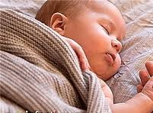
maradidel muhajirTa STamomavlებis _ saqarias (adabazari) provinciis geives raionis sofel ilimbeiSi 2018 wეls Caweril saakvno leqs-simReraSi Cvili gogonas silamaze mzesa da mTvaresTan aris Sedarebuli:.
mTvare xar Tu mze xar Tu,
ra soÁ lamazi xaro!
deÁzinos da geÁzardos
Cemi lamazi gogo!
ee, ee, ee...
sayuradReboa, rom qarTvel muhajirTa “nanebSi” Semonaxulia akvnis moferebiTi saxeli “k a k a n a”, rac bolo dromdea SemorCenili saqarTvelos sxvadasxva kuTxeSi; qojaelis provinciis goljuqis raionis sofel aivazfinarSi (Zveli saxelia CaTaltaSi) klarj muhajirTa STamomavlებისაგან 2013 wელს Cawerili saakvno leqs-simReris mokle variantი ამგვარია;
nani, nani, nanaÁ,
deÁZine kakanaÁ.
მუჰაჯირთა შთამომავლების სააკვნო ლექს-სიმღერების ძირითადი თემებია:
1. Cvilisadmi unazesi siyvarulis gamoxatvა,
2. ciur mnaTobebTan misi Sedarebა,
3. ჯარისკაცად გახდომის სურვილი, კარგი მომავალი.

Slide 7
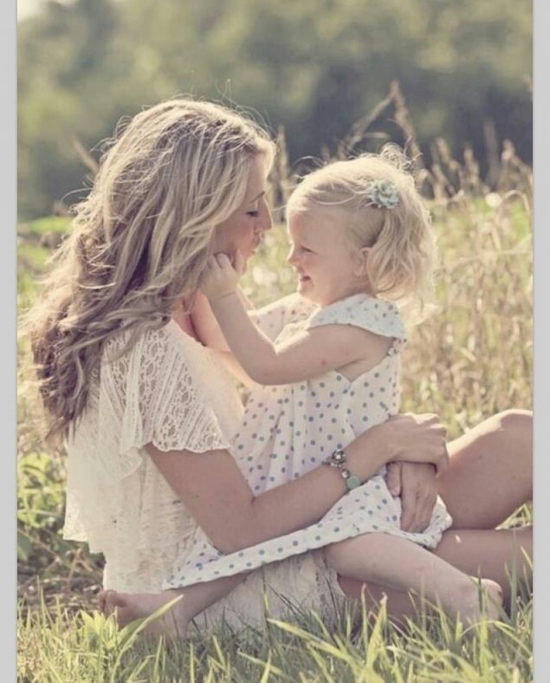
2. salalao da Sesaqcevari
qarTvel muhajirTa STamomavlebis folkloruli Semoqmedeba sakmaod mdidaria salalao da Sesaqcevari leqs-simRerebiT. am rigis nawarmoebebs ufrosebi maSin asruleben bavSvebisaTvis an Tavad bavSvebi, roca maTi cxovrebis ZiriTad Sinaarss garToba da TamaSi gansazRvravs. maT umetesobas praqtikuli datvirTva gaaCnia. amgvaria leqsi “...w ი p o, w i p o...”, romelic bolo dromde mraval variantad aris gavrcelebuli rogorc saqarTvelos yvela kuTxeSi, ise TurqeTis respublikis SemadgenlobaSi myof istoriul qarTul provinciebsa da mis centralur raionebSi gansaxlebul qarTvel muhajirTa STamomavlebis zepirsityvierebaSi.

Slide 8
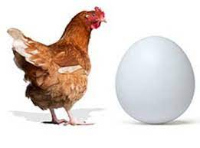
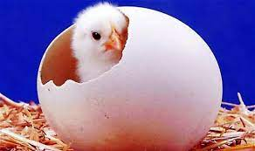
ordus provinciis unies raionis sofel aRidereSi 2016 wელს Cawerili leqsi “... w i v, w i v...” zogadqarTulsa da klarjul sabavSvo zepirsityvierebaSi gavrcelebul nimuSTa variantia:
wiv, wiv, wipolaÁ,
qaTmis kvercxi miWamia,
pirze mcxia, mixaria!
bulu, bulu, bulu!..
rogorc mTqmelma ganmarta, am saymawvilo TamaSisas bavSvTan erTad ufrosi (ufrosebi) xelis zurgiT erTmaneTs CaeWidebian, zeviT-qveviT aqaneben da amboben leqss, bolos xelebs auSveben, gaSlian da erTxmad ityvian: “bulu, bulu, bulu!..”
am leqsis mravali varianti Caviwere 2012-2018 wlebSi ordus provinciis unies raionis soflებში.

Slide 9
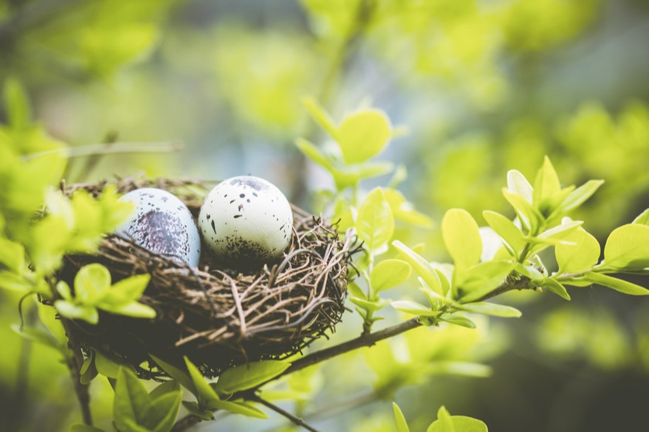
amasiis provinciis TaSovas raionis sofel taTlifinarSi mcxovrebi maWaxlel muhajirTa STamomavlებisაგან 2016 wეls Caviwere leqsi “... wip, wip, wapela...”, romelic saqarTvelos TiTqmis yvela kuTxeSi bolo dromde cocxal folklorul brunvaSia:
wip, wip, wapela...
Citi kvercxi miWamia,
pirze mcxia, mixarian!)
bulu, bulu, bulu!..
am Sesaqcevari leqsis funqciaa, daexmaros aRmzrdels bavSvis kvebisas, gaamxiarulos da gaarTos igi. zogadqarTul folklorSi gavrcelebul am leqsis variantebSic aqcenti gamaxvilebulia kvercxis Wamaze, romelsac “nakvalevi” dautovebia pirze, rac ymawvilTa gamxiarulebas iwvevs:
wi, wi, wiqoria,
mTasa kvercxi gipovnia,
gisvia da giWamia,
pirsa gcxia, gixaria.

Slide 10
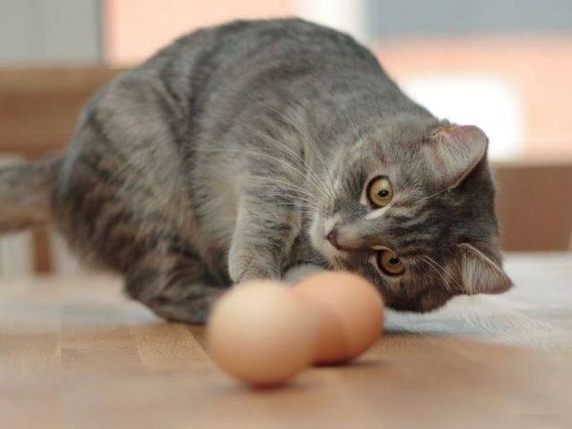
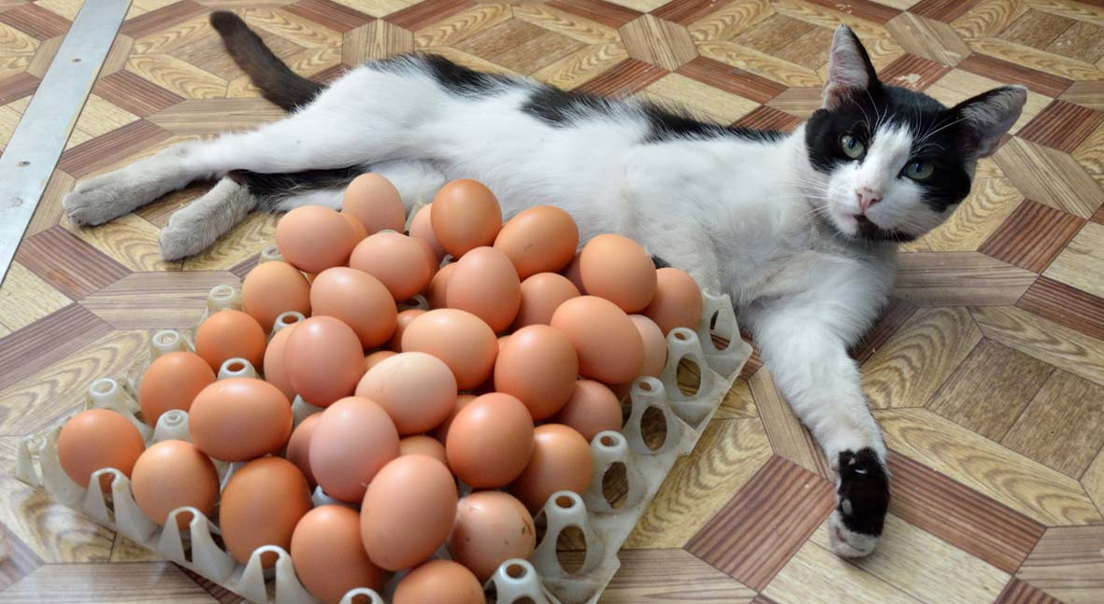
umetesi variantebis Tanaxmad, kvercxis povna da SeWma katas braldeba da mas dascinian moTxupnuli piris gamo:
wipo, wipo, wipolaÁ,
katam kvercxi SeWama,
bukze miisva.
erT-erTi aWaruli variantiTac, katas uxaria, rom kvercxi pirze scxia:
wipo, wipo, wiponia,
fisos kvercxi uWamia,
pirze scxia, uxaria,
xara, xara, xara...
SeuWamia guli,
Suwuxebia suli,
ulvaSebi SeRebia,

Slide 11
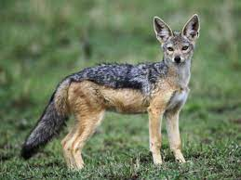
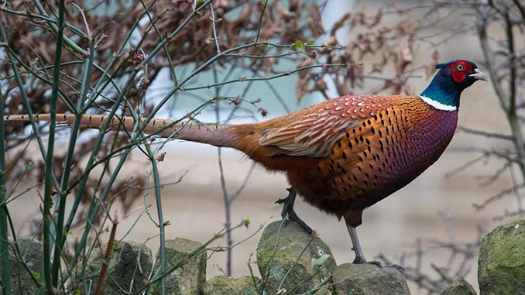
aWarel (qobuleTel) muhajirTa STamomavlis _ ordus provinciis facas raionis sofel TahTabaSSi mcxovrebi 60 wlis jelal qarasusagan 2012 wlis 14 ivliss Cawerili teqsti am rigis leqsTa adgilobrivi versiaa:
anazizis yanaSi
tura goravs nacarSi;
ხoხbis kvercxi miWamia,
bala, bala, bala!..
TamaSis wesi igivea; mTqmelis ganmartebiT, “xelis zurgze Caabam, ityvi; bolos ityvi “bala, bala” da xeleb gaSli”.

Slide 12
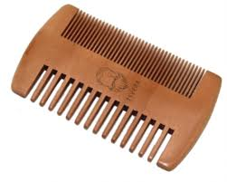
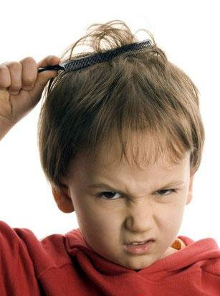
Tmis varcxnasTan dakavSirebuli saintereso sabavSvo leqsi Caviwere amasiis provinciis amasiis centraluri raionis sofel beldaRSi maWaxlel muhajirTa STamomavlis _ 50 wlis neriman Sahinisagan 2016 wlis 18 agvistos. leqsSi moxseniebulia xuWuWa (“kuWkuWa”) Tmis varcxna, xolo bolo sityva, romelic samjer meordeba, tradiciuli Sesaqcevari leqsebis daboloebaa:
kuWkuWooba,
mindeerze,
mis babaÁ kindeerze.
bulu, bulu, bulu...
mTqmelis ganmartebiT, “Tmis davarcxnisas umRereben baRanas”.
kuWubana,
savarcxalia.
narcxi-nurcxi vin Wama?
erbo-kvercxi vin Wama?

Slide 13
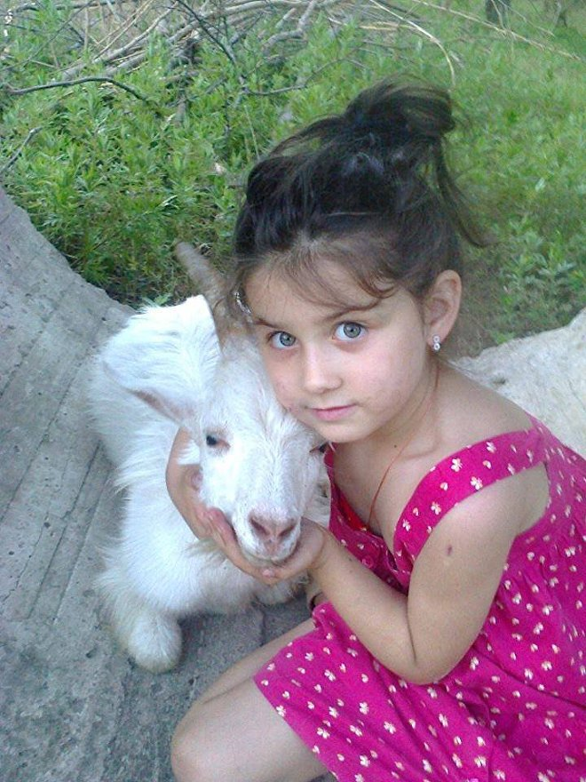
aWarel muhajirTa STamomavlebSi, romlebic binadroben ordus provinciis sofel TongelduzuSi, gavrcelebulia salaRobo xasiaTis saymawvilo leqsi, romelSic gamoTqmulia TamaSiT garTuli ymawvilis sixaruli, kmayofileba da, amave dros, molodini dedisa, romelic mova da daapurebs:
axors ukan Tiknebio,
viTamaSeb, viqnebio;
neneÁ mua, ÁaRsac momcems,
viTamaSeb, viqnebio!
am leqsis varianti, romelic ordus provinciis qabaduzis raionis sofel qirazdereSi (Zveli sulTanie) aWarel muhajirTa STamomavlisაგან Caviwereთ 2012 wეls, mcirewlovanTa repertuaria da gadmoscems dedis gverdiT myof ymawvilTa sixaruls, rom deda rZiT daapurebs:
iger, gaRma, duqnebi,
me nenesTan viqnebi;
neneÁ me Zes maWums,
viTamaSeb, viqnebi.
mTqmelma ganmarta, rom es leqsi mSoblebisagan dauswavlia: “_ babam, nenem mawavla”.

Slide 14
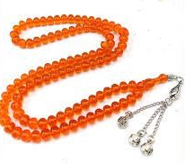
aWarel muhajirTa STamomavlებs შორის დადასტურდა sabavSvo leqsis _ “q u m S i, q u m S i” amebeuri teqsti, რომელიც, agreTve, ymawvilTa gasaxalisebel-gasamxiarulebelia:
_ qumSi, qumSi,
Seni baRana had ari?
_ askerSi wevda.
_ roÁs’da movdos’dao?
_ guSin-dRes wamua.
_ raÁ’na mogitanos’dao?
_ puwvan-puwvana Tesbebi momitanos’dao.
_ Sen da me gavarigoT Suazeo!

Slide 15
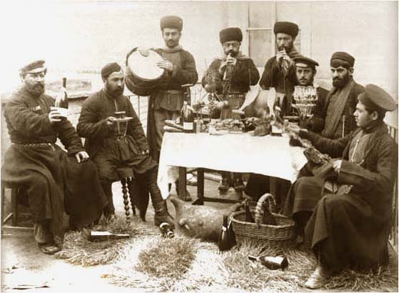
G 3. გamosajavrebeli
gamosajavrebeli, anu saginglao, leqsebi xalxuri sabavSvo poeziis erT-erTi saintereso ubania, romelic mTlianad bavSTa repertuaria, maTi fiqrebis, azrebis, daskvnebis gamoxatulebaa, Tumca, bunebrivia, Tavis droze ufrosTa mier aris Seqmnili. gamosajavrebeli leqsebi xSirad gasakilavad SerCeuli bavSvebis saxelebTan SeriTmuli striqonebia.
amgvariა ლeqs-simRera, რომელიც profesorma mamia faRavam Caiwera 2012 wlis 20 ivliss ordus provinciis ulubeis raionis sofel refaieSi:
_ gogov, gogov, Tinikov,
wuxel SenTan vin iyo?
_ asi movda, asi wevda,
me ra vici, vin iyo!
amgvari dialoguri formis leqsi bursis provinciis
inegolis raionis sofel hairieSi aWarel muhajirTa
STamomavlisაგან 2014 wელს:
_ iliko, miniko,
wuxel SenTan vin iyo?
_ wasul-mosul biWebi,
me ra vici, vin iyo!
am leqs-simReris aWaruli (da zogadqarTuli) varianti amgvaria:
_ Tiniko, Tiniko,
wuxel TqvenTan vin iyo?
_ loTebi, loTebi,
daamtvries boTlebi.

Slide 16
4. leqsebi frinvelebsa da cxovelebze
qarTuli saymawvilo zepirsityviereba mdidaria iseTi leqsebiT, romelTa personaJebic frinvelebi da cxovelebi arian. amgvari nimuSebi xSirad siuJetiani nawarmoebebia, romlebic galeqsil zRaprebs waagaven da swored amiT xdebian bavSvebisaTvis saintereso; maTi mosmeniT mozardebs uviTardebaT maTTvis sasurveli ambebis mosmenisa da Semecnebis unar-Cvevebi. amgvari folkloruli nimuSebi CaviwereT qarTvel muhajirTa STamomavlebs Soris.
ordus provinciis unies raionis sofel CaTalfinarSi 2012 wელს Cawerili leqs-simRera “... z a v a l i t u r a v i y a v i...”, romelsac mTqmeli balavanis akompanementis TanxlebiT asrulebda, mogviTxrobs turas mier dedlisa da mamlis motacebisa da bolos misi xafangSi gabmisa da sikvdilis istorias:
zavali tura viyavi,
viarebodi didvan tyÁebSi,
ro momSivdeboda,
SevZrebodi faSias kariaSi.
erT dRes kidev momSivda,
SevZveri kariaSi,
devWire erTi dedali,
gevqeci qoTi kiruRSi.
meore dRes ki momSivda,
SevZveri kariaSi,
devWire erTi mamali,
iyvira mamalma,
gevqeci qoTi kiruRSi.
devfiSmandi da Zalvan
Sieri viyavi.
karieÁs gzaSi faSias
duudevia xundi.
Zalian Sieri ro viyavi,
ver devnaxe xundi.
imxela rome viyvire,
geigones sofelidan.
xundis erTaT imiyvanes
did mindorSi.
gakuWebuli faSiam
erTi ro waldi damartya,
tvini demebnia TavSi.
mTqmelis ganmartebiT, es ambavi asi wlis win momxdara. leqsi gaugonia didedasagan (“didneneÁdan”): “ _ Cemi dedaÁs (neneÁs) didneneÁ iyo, iman TurqCe ar icoda; aq moxda, asi weliwadi zeÁT aq iyo”.

Slide 17
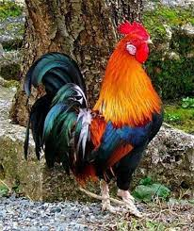
qarTuli xalxuri saymawvilo leqsebis erT-erTi popularuli personaJia mamali, romelTan dialogsac siuJetis jaWviseburi ganviTareba mosdevs. amgvaria “... _ yiyliyoo! _ mamalo, sad yivi?..” am leqsis variantebi Zalze gavrcelebulia saqarTvelos yvela kuTxeSi da, maT Soris, saqarTvelos istoriul regionebSic. maradidel muhajirTa STamomavlებში:
_ yiyliyo, mamalo,
kalo-kalo CameÁare!
bero, cxeni visia,
alisa Tu malisa?
_ TavaT dodofalisa!
sami qilo marili
Tagvs ulokia,
Tagvi avaT gamxdara,
kata mosula.
_ buÁuqlidav, ra gindoda?
yurcmetiav, ra gindoda?

Slide 18
amebeuri xasiaTis saymawvilo leqsi, romelic mamlisa da melas dialogzea agebuli, Caviwere 2012 wlis 16 ivliss samsunis provinciis CarSambas raionis sofel qesTanefinarSi mcxovreb aWarel muhajirTa STamomavlis _ 23 wlis islam qusesasagan:
mamali: _ yi, yi, yi...
mela: _ mamalo, ha yivi?
mamali: _ jinWarSi.
mela: _ ra gacvia?
mamali: _ babuCi.
mela: _ vin igiRo?
mamali: _ aRam.
mela: _ aRa had ari?
mamali: _ xidze geÁara.
mela: _ xidi had ari?
mamali: _ wyalma weÁRo.
mela: _ wyali had ari?
mamali: _ Zroxam Sesva.
mela: _ Zroxa had ari?
mamali: _ danam dakla.
M ela: _ dana had ari?
mamali: _ usTam weÁRo.
mela: _ usTa had ari?
mamali: _ usTam mokta.
mela: _ imisi Wliki mogxda!

Slide 19
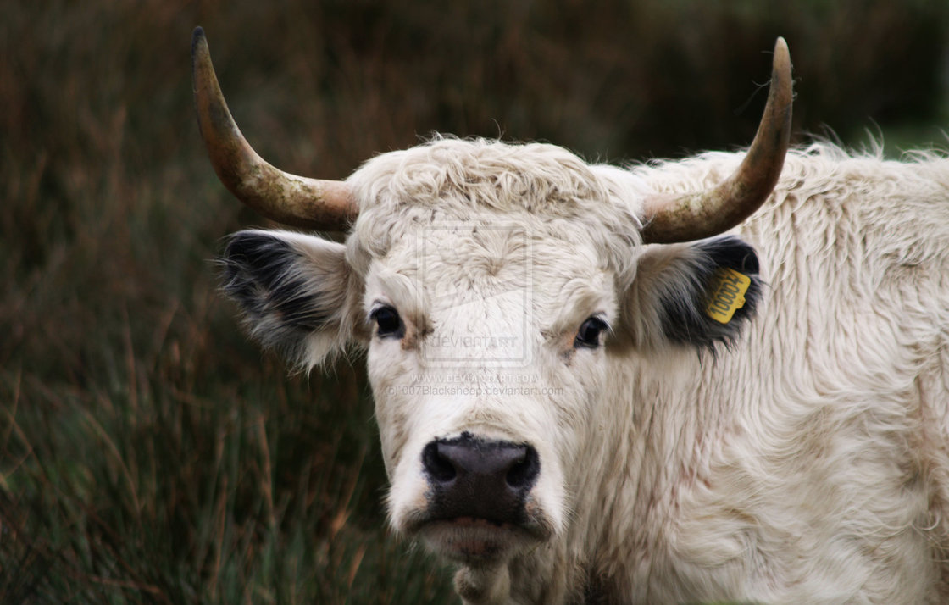
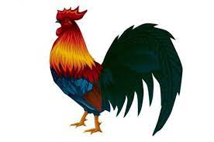
TiTqmis identuri variantebi gvxvdeba aWaris zepirsityvierebaSic; (bolo striqonis (“misi Wlikebi mogxda!”) Tqma daswrebazea.
_ xari had ari?
_ danam dakla.
_ dana had ari?
_ kacis jibeSi.
_ kaci had ari?
_ mokda._ imis trinkebi mogxda!
gamarjvebuli is aris, vinc bolo sityvebis Tqmas daaswrebs.
aWarel muhajirTa STamomavlis _ ismail quses sabavSvo leqs-simReraTa mdidari repertuaridan sayuradReboa, agreTve, leqsi “... mamalaÁ...”, romlis Temaa wuxili ZaRlis mier gatacebuli didi mamlis gamo, romelsac sami coli (“qali”) hyolia, “baRnebi” (wiwilebi) umamod darCenilan:
mamalaÁ da mamalaÁ
Cemi didi mamalaÁ!..
sami qali qonda...
Cemi didi mamalaÁ
ZaRlma weiyvana,
baRnebi marto darCa!
mamalaÁ da mamalaÁ
Cemi didi mamalaÁ!..

Slide 20
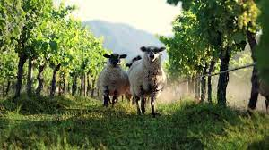
sayuradReboa, rom maradidel muhajirTa STamomavlebma Taviseburad Semoinaxes xsovna qarTuli xalxuri saymawvilo leqsisa “modi, vnaxoT venaxi“:
daTvma _ geli,
gelma _ Rori,
Rorma _ viri,
virma _ cxvari,
cxvarma venaxi SiWama.

Slide 21
5. sabavSvo TamaSebi da gaTvlebi
zepirsityvierebis nimuSTagan, romlebic umTavresad erTvian da warmarTaven sabavSvo TamaSobebs, saqarTvelos TiTqmis yvela regionSi popularulia “...ც e r a m T q v a...” am TamaSis pedagogiur-aRmzrdelobiTi misiaa,
1.ymawvilebSi ganaviTaros cnobismoyvareoba;
2. SeagrZnobinos sakuTari sxeulis nawilebi;
3. daamaxsovrebinos maTi saxelebi (am SemTxvevaSi _ TiTebisa);
4.misces garkveuli zneobrivi sentencia, rom qurdoba da dasmena adamianis mankieri Tvisebebia;
5. gamoiwvios jansaRi sicili da erTgvari kmayofileba, rodesac dasmenis msurvel neka TiTs “dasjian” da “urtyamen”.

Slide 22
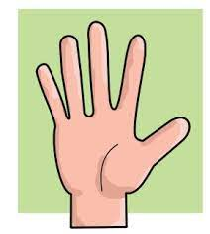
maWaxlel muhajirTa STamomavlebis istoriul mexsierebas, SavSeTeli da klarji Cveneburebis msgavsad, kargad Semounaxavs es uZvelesi sabavSvo TamaSi da masTan dakavSirebuli narativi. amasiis provinciis TaSovas raionis sofel taTlifinarSi 2016 წეls Cawerili nimuSi amgvaria:
amaÁ, ceraÁ TiT, uTqmia: _ me mSiao!
amaÁ, salok TiT, uTqmia: _ raÁ gindao?
amaÁ, SuaÁ TiT, uTqmia: _ visaqmoT da vWamoTo!
amaÁ, beWdi TiT, uTqmia: _ mevparoT da vWamoTo!
leki TiTsac uTqmia: _ gagamJRavnebTo!
“ _ imitom urtymian iSte da puwuwuli darCenila”, _ dasZina mTqmelma.
maWaxlel muhajirTa STamomavlebs Soris bolo dromde gavrcelebulia TamaSi “beWdis oini”, რომელიც Semdegnairad warimarTeba: “meviyrebodiT, vincxas zurgs ukan beWed dadebda erTi kaci. is dadebs, Sen ukan ar unda Sexedo, TiTebiT unda moZebno; Tu moZebni, maSin Sen dadeb beWed”.

Slide 23
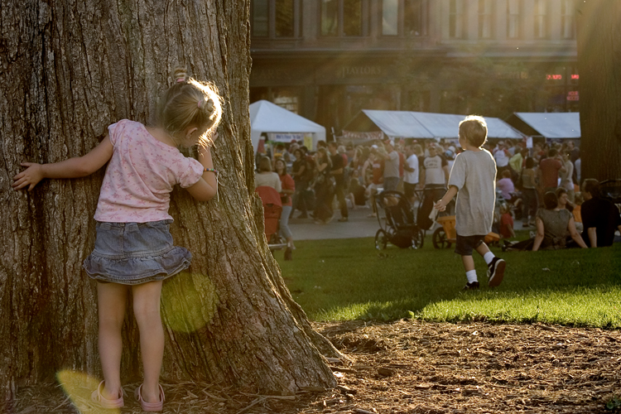
qarTvel muhajirTa STamomavlebma Semoinaxes, agreTve, sabavSvo TamaSebi damalobana (“kukumalaÁ”, “Witi-kuku”), kenWobia, anu “xuTi qva”.
saqarias (adabazari) provinciis geives raionis sofel mahmudieSi mcxovrebi maradideli muhajirebis STamomavlებში გვითხრეს: “ _ damalobanas viTamaSebdiT, “vaSli vityodiT _ gamoÁ, “msxali” vityodiT _ daimale!”

Slide 24
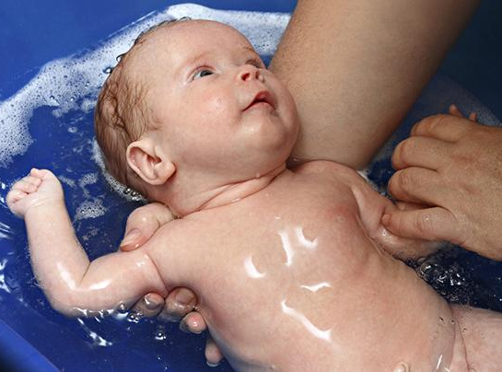
Cveneburebs Soris gavrcelebuli sabavSvo TamaSi “xuTi qva”, anu “kenWobia, iseTivea, rogorc _ yvelgan saqarTveloSi.
maWaxlel muhajirTa STamomavlebis folklorul-eTnografiulma yofam Semoinaxa, agreTve, saqarTveloSi bolo dromde SemorCenili wes-Cveuleba, romlis Tanaxmadac, Cvils tans rom dabanen, bolo wylis gadasxmis Semdeg fexebiT Tavqve dahkideben da samjer dalocaven: “_ daTvi mWle da Sen msuqani!” analogiurad iqcevian maWaxlelTa STamomavlebic; beldaReli qalbatonis _ neriman Sahinisagan Cawerili “Cvilis dalocva” identuria zogadqarTulisa:
daTvi Wle da Sen suqani!
daTvi Wle da Sen suqani!
daTvi Wle da Sen suqani!
“ _ baRanas tans ro davbandiT, fexebiT davkidebdiT da samjer vetyodiT”, _ gangvimarta mTqmelma.

Slide 25
qarTvel muhajirTa STamomavlebis zepirsityvierebaSi bolo dromde cocxal folklorul brunvaSi SemorCenili sabavSvo folkloris nimuSebi, sabavSvo TamaSobani da maTi Tanmxlebi narativebi imis dasturia, rom Cveneburebi momaval Taobas winaparTa zneobrivi gamocdilebiT zrdian, xalxuri sibrZnis aprobirebuli meTodebiT akaJeben maT moqalaqeobriv suliskveTebas; ისინი umTavresad ZirZveli qarTuli xalxuri saymawvilo zepirsityvieri Semoqmedebis tradiciuli variantebia.
გმადლობთ ყურადღებისათვის!

