Slide 1


BATUMI SHOTA RUSTAVELI STATE UNIVERSITY
Georgia
Ivdit Diasamidze

Slide 2





Slide 3
Ivdit Diasamidze
Associate Professor, PhD
Department of European Studies
Head of Quality Assurance Service at The Faculty of Humanities

Slide 4

Language proficiency is a critical factor in student success in higher education, where effective communication skills are essential for academic achievement and professional growth.
Traditional teacher-centered methods often limit student interaction, making language learning passive rather than engaging.
Cooperative Language Learning (CLL) offers an alternative approach that fosters collaboration, active participation, and peer-assisted learning.
This study examines the effectiveness of Cooperative Language Learning in higher education, focusing on its impact on students' language proficiency, engagement, and academic performance.

Slide 5
The Effectiveness of Cooperative Language Learning in Higher Education
The research aims to: (1) examine the effectiveness of cooperative learning in improving students' proficiency and (2) and analyze student engagement and learning outcomes in cooperative learning environments. Hence, we will try to
Investigate the effectiveness of cooperative learning strategies in improving language proficiency.
Identify specific CL methods (e.g., think-pair-share, role-playing, jigsaw activities) that enhance language learning.
Analyze student engagement and performance in language-based cooperative activities.
Provide recommendations for integrating cooperative learning into higher education curricula.
By examining these aspects, the research will contribute to educational practices that enhance language learning outcomes for university students.
Methodology
Research Design
This study employs a mixed-methods approach, combining qualitative and quantitative data collection techniques. The primary objectives are to: Assess the impact of cooperative learning on students' language proficiency. Analyse student engagement and learning outcomes in cooperative learning environments.

Slide 6
Definition of Cooperative Language Learning (CLL)
Cooperative Language Learning (CLL) falls under the broader instructional framework known as Collaborative Learning (CL). It represents a teaching approach that emphasizes the extensive use of cooperative activities involving pairs or small groups of students within the classroom setting. (Richards and Rodgers, 2001).
Cooperative Learning has been defined as:
A form of group learning activity structured in such a way that learning relies on the socially organized exchange of information among group members. Each student is individually responsible for their own learning while also being encouraged to contribute to the learning of their peers.

Slide 7
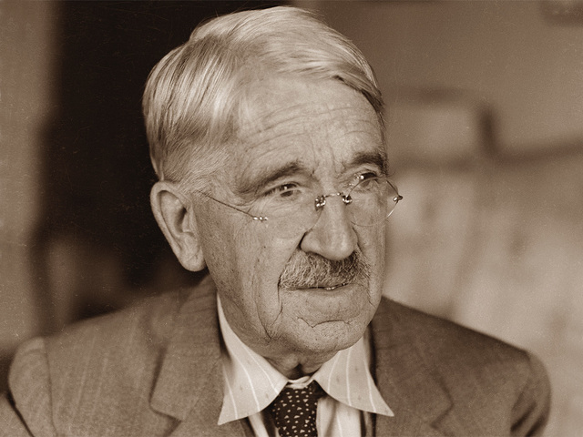
History of Cooperative Learning
Cooperative Learning has its roots in long-standing practices of peer tutoring and peer monitoring, traditions that span back hundreds of years. The concept of integrating cooperation systematically into classroom instruction is most commonly associated with early 20th-century American educator John Dewey
In the United States, Cooperative Learning gained broader attention and development during the 1960s and 1970s
Educators at the time were increasingly critical of traditional classroom models, which were typically teacher-centered, encouraged competition over collaboration, and tended to advantage majority students.

Slide 8
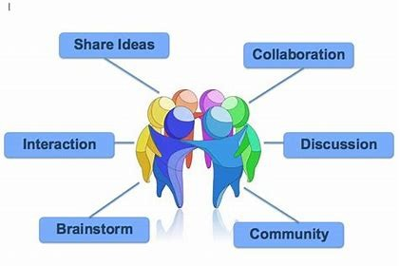
There was concern that minority students were at risk of falling behind their higher-achieving peers in such environments. Cooperative Learning emerged as a strategy to address these concerns by aiming to:
Improve academic outcomes for all students, including both gifted and academically challenged learners
Support teachers in fostering positive student relationships
Provide students with the social, psychological, and cognitive experiences essential for healthy development
Replace the competitive structure of conventional classrooms with a collaborative, team-oriented, high-performance model
(Johnson, Johnson, and Holubec, 1994, p. 2)

Slide 9
Cooperative Language Learning (CLL)
CLL is a student-centered approach that encourages interactive learning through structured group activities. Research suggests that cooperative learning strategies enhance engagement, critical thinking, and problem-solving skills
CLL fosters a collaborative environment where students actively participate in discussions, share knowledge, and support each other’s learning.
In the field of second language instruction, Cooperative Learning—commonly referred to as Cooperative Language Learning (CLL)—has been widely adopted as a means of fostering communicative interaction within the classroom.
It is regarded as a natural extension of the principles underlying Communicative Language Teaching and represents a learner-centered approach that is considered more beneficial than traditional teacher-led instruction.

Slide 10
Within language education, CLL aims to:
Create opportunities for natural second language acquisition through interactive pair and group work
Equip teachers with practical methodologies adaptable across different instructional settings, such as content-based programs, foreign language classes, and mainstream classrooms
Allow for targeted focus on vocabulary, grammatical structures, and communicative functions via interactive tasks
Support learners in developing effective learning and communication strategies
Increase learner motivation, reduce anxiety, and foster a positive emotional climate in the classroom climate.

Slide 11
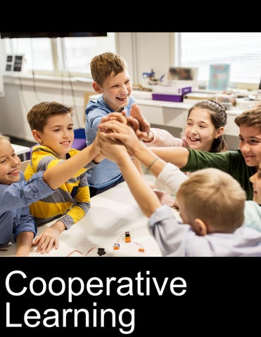
Benefits of CLL in Higher Education
Studies highlight the positive impact of CLL on language acquisition, including improved vocabulary retention, oral fluency, and academic writing skills
Cooperative learning methods also promote student motivation and confidence, creating an inclusive and supportive classroom atmosphere

Slide 12
From the perspective of second language teaching, McGroarty (1989) offers six learning advantages for ESL students in CLL classrooms:
increased frequency and variety of second language practice through different types of interaction
possibility for development or use of language in ways that support cognitive development and increased language skills
opportunities to integrate language with content-based instruction
opportunities to include a greater variety of curricular materials to stimulate language as well as concept learning
freedom for teachers to master new professional skills, particularly those emphasizing communication
opportunities for students to act as resources for each other, thus assuming a more active role in their learning.

Slide 13
Results and Discussion
The effectiveness of Cooperative Learning (CL) relies heavily on how group work is organized and implemented. It demands a well-structured learning program that is thoughtfully planned to ensure that students actively engage with one another and are encouraged to support and enhance each other’s learning.
Olsen and Kagan (1992) identify several essential elements for effective group-based learning within Cooperative Learning (CL). These include:
Positive interdependence
Group formation
Individual accountability
Social skills
Structuring and structures

Slide 14
Positive interdependence is established when group members recognize that each person’s success benefits the whole group, and setbacks affect everyone. This sense of mutual responsibility is fostered through the design of CL tasks and by promoting a collaborative group dynamic. For instance, a group might be required to produce a single shared outcome, such as a group essay, or their scores might be averaged to reflect overall performance.
Group formation plays a vital role in fostering positive interdependence. Key considerations in forming groups include:
– Determining group size: This depends on factors such as the nature of the task, students’ age, and the time available. Groups typically consist of two to four members.
– Assigning students to groups: While groups can be formed randomly, by student choice, or teacher selection, teacher-assigned groups are generally preferred to ensure diversity based on factors like academic ability, ethnicity, or gender.
– Assigning roles within the group: Each member takes on a specific responsibility, such as noise monitor, turn-taker facilitator, recorder, or summarizer.
Individual accountability ensures that each student contributes meaningfully to the group’s work. This can be achieved by grading each student’s portion of a group task or by randomly selecting students to present their work to the class, their group, or another group.
Social skills are crucial for effective collaboration. Students often need direct instruction in interpersonal skills to interact productively as team members.
Structuring and structures refer to the methods used to organize student interaction and define how students are expected to work together during cooperative activities.

Slide 15
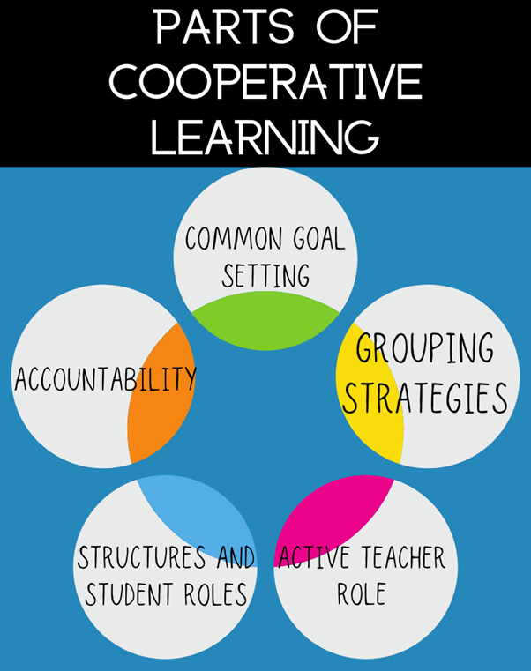

Conclusion
Although teacher’s role in Cooperative Language Learning (CLL) is significantly different from that in traditional, teacher-centered classrooms, in CLL, the teacher is responsible for creating a structured and well-organized learning environment, which involves setting clear objectives, planning and organizing tasks, arranging the physical setup of the classroom, assigning students to specific groups and roles, and choosing appropriate materials and managing time effectively.
A key responsibility of the teacher is to act as a facilitator of learning. In this role, the teacher moves throughout the classroom, providing guidance and support to individual students and groups as needed.
The use of discussion groups, group work, and pair work has long been recommended in both language teaching and other academic disciplines. These formats are often introduced to vary classroom routines and to increase student engagement.
In Cooperative Learning (CL), group work serves as the core instructional method and is grounded in a structured, theoretical framework for using collaborative activities in education. These group tasks are carefully designed to maximize student interaction and promote mutual support in learning.
Despite positive evidence, CLL is not without criticism. Some argue that it may be less effective for learners at certain proficiency levels—for example, suggesting that intermediate and advanced students may benefit more than beginners.
The method places significant demands on teachers, who must adjust to new roles and instructional practices.
CLL enhances both academic learning and interpersonal communication skills among students.

Slide 16

Thank You For Your Attention!!!

